Slide 1

Science & Technologies Exchange Platform for Students (STEPS) 2016
Insert presenter names here

Slide 2
Science & Technologies Exchange Platform for Students (STEPS) 2016
The objective of the project is to help locate the elderly with mental illnesses like, Alzheimer's disease.
Since they have mental illnesses, they might wander off or forget where their going and get lost.
So a way to allow family members or close friends to locate the elderly is the main objective of the project.

Slide 3

Science & Technologies Exchange Platform for Students (STEPS) 2016
Using GPS is needed to provide accurate coordinates, allowing users to pinpoint where exactly are the elderly.
In case GPS is unavailable indoors or underground, Wi-Fi info is also needed. This allows users to see any familiar Wi-Fi SSID names around the elderly, helping to locate them.
There are 2 ways to allow us to track the elderly:
Using a device and an application, by giving the device to the elderly, the user is able to track the elderly at all times with a downloaded application on the user’s phone.
Using applications only, by downloading an application on the elderly and the user’s phone, both of their phone can communicate with each other and send each other the information.

Slide 4

Science & Technologies Exchange Platform for Students (STEPS) 2016
 | Device and App | Application Only
Functionality | 5 | 5
Effectiveness | 4 | 4
Energy/Cost Saving | 2 | 4
Creativity | 2 | 4
User friendly | 3 | 5
Total | 16 | 22

Slide 5

Science & Technologies Exchange Platform for Students (STEPS) 2016
The device and application design was not chosen, as the device may be bulky and the elderly may just find it annoying, leaving it in the house.
The application only design was chosen, because the elderly will use and take care of their phone more, since it has other functionalities that they can use.
This also allows multiple methods for applications to communicate with each other and it was decided to use SMS, for elderly with no internet, and server, for elderly with data plans or internet.

Slide 6

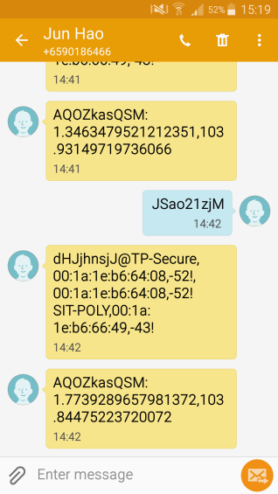
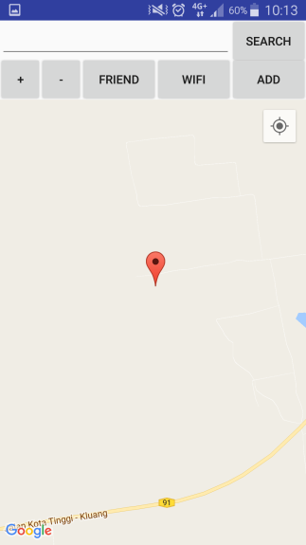
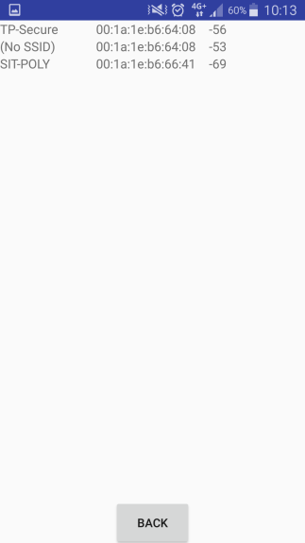
Science & Technologies Exchange Platform for Students (STEPS) 2016
For the final product, 2 versions of applications were created for tracking the elderly. The first application was using the SMS method to relay information. The app will prompt the user to choose a person from their contact list and it will send a SMS with a code to the chosen phone. The application will detect the code and send the info on a SMS back to the user, and the user’s app will take the info and display it on the phone.
Request Information
Sending Information
Start
1st Phone
“Request” Sent
2nd Phone
Detect “Request”
“Info” Sent
Detect “Info”
End

Slide 7
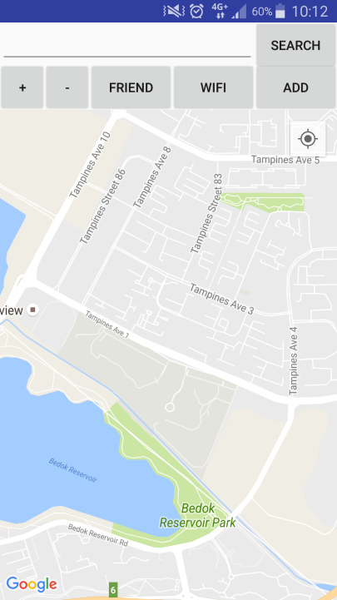
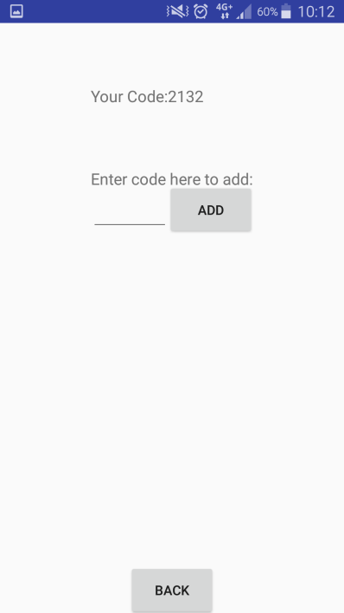
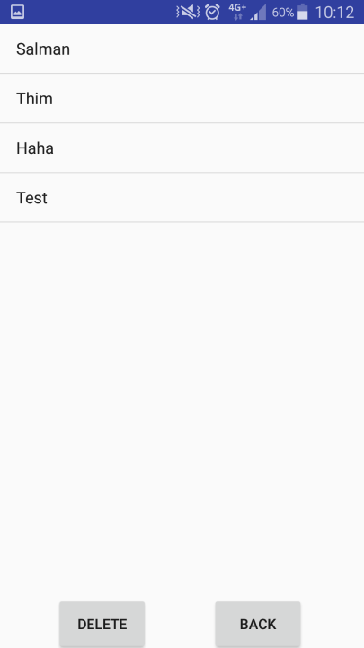
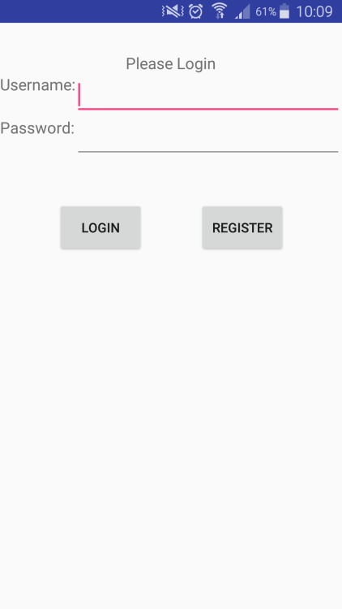
Science & Technologies Exchange Platform for Students (STEPS) 2016
For the second application, it uses a server to collect and send information. The user and elderly must create an account and login t their account in the app. The application will automatically send their information to the server once their logged in. They must also add each other to their friend list with their specific code. Then they may track and see their information from their friend list at anytime.

Slide 8

Science & Technologies Exchange Platform for Students (STEPS) 2016
In this section of the presentation, your team can discuss on:
what the team has learnt through this project
the problems encountered during the project development
how the team has managed to resolve those problems
strengths and limitations of your final product
recommendations for future improvement.

